Slide 2

Agenda
Opening
Achievements & Project
Learning & Growth
Challenges & Overcoming
Better version of myself

Slide 3
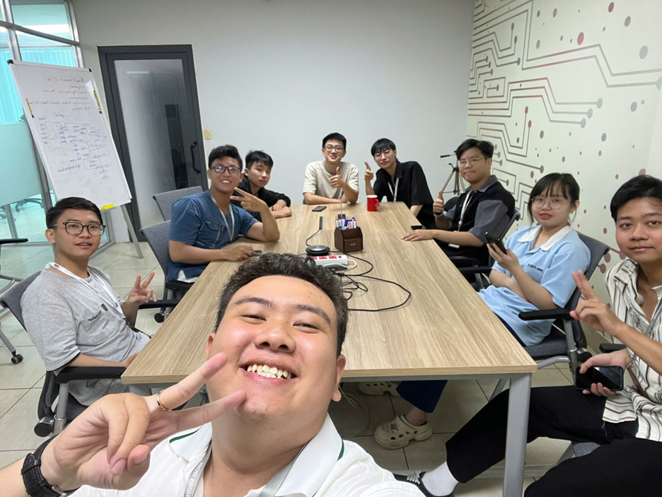
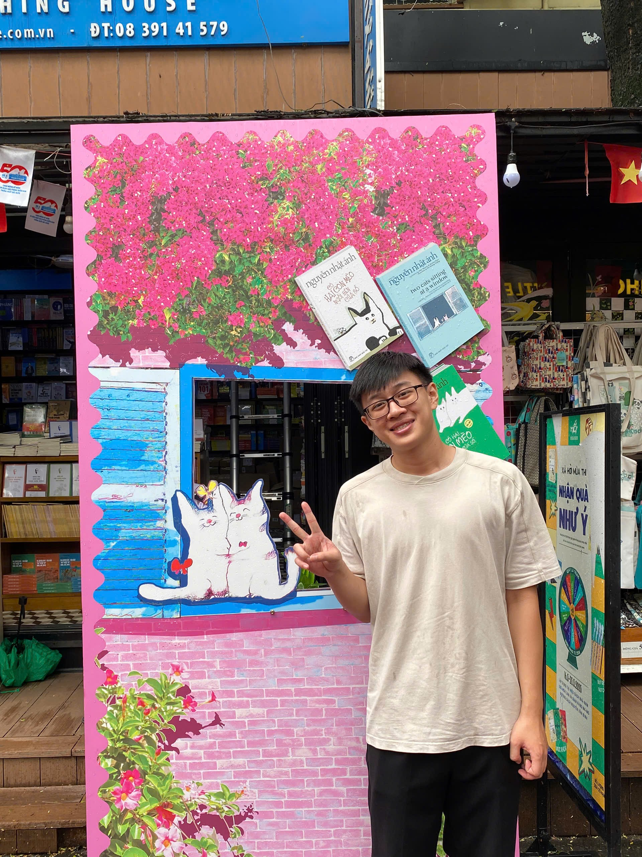
YPP4 -TEAM

Slide 4
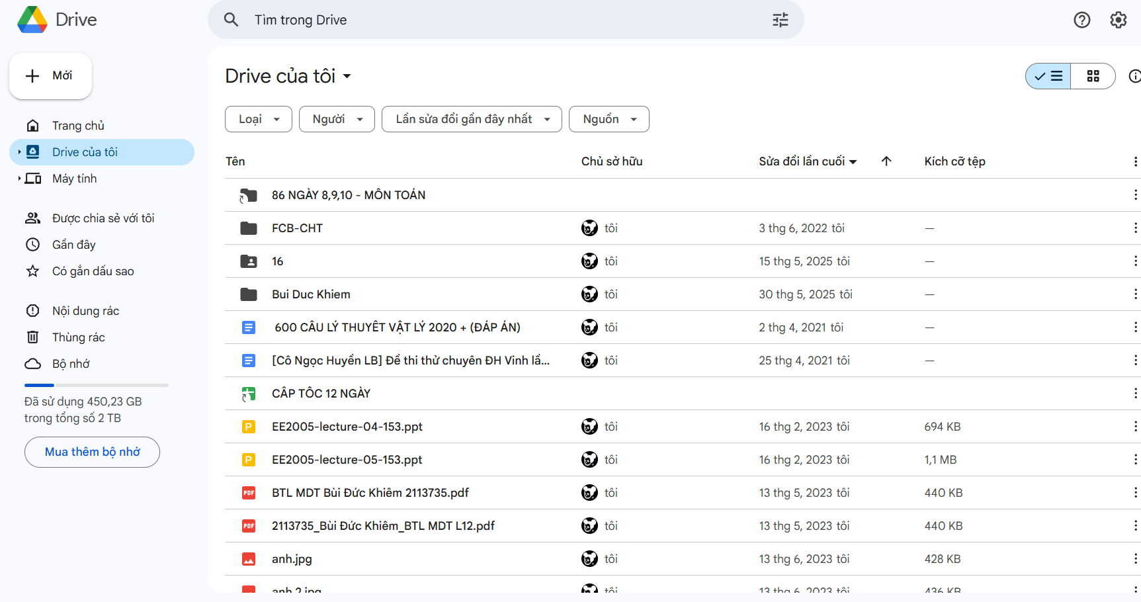
Analysis Requirement

Slide 5
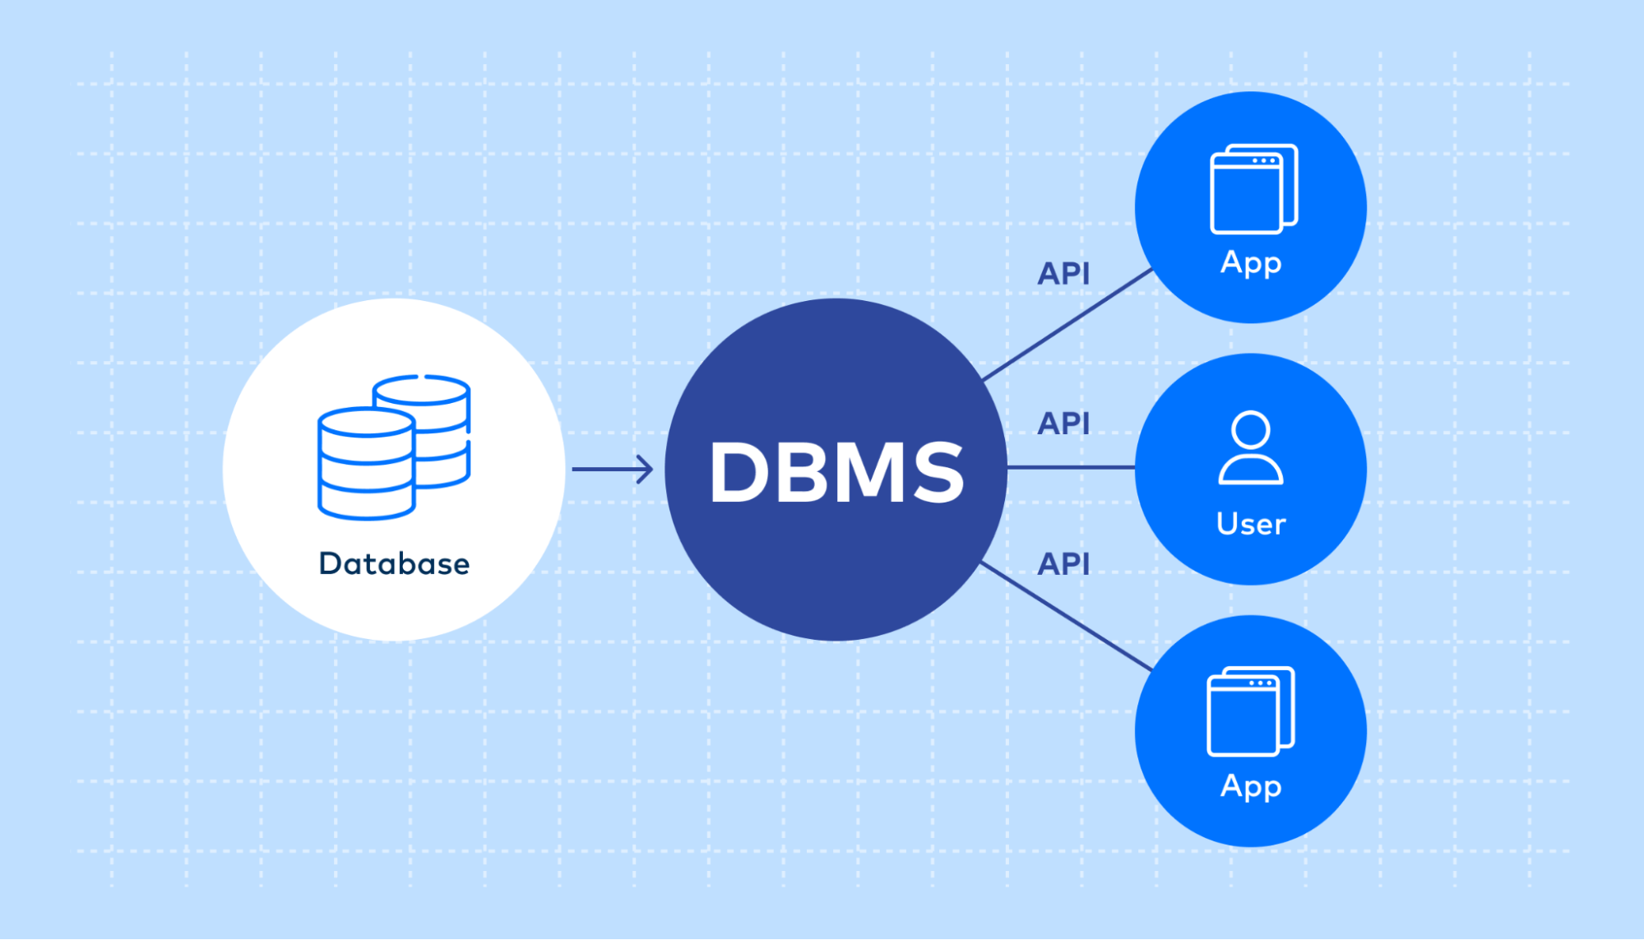
Database

Slide 6


Programming

Slide 7
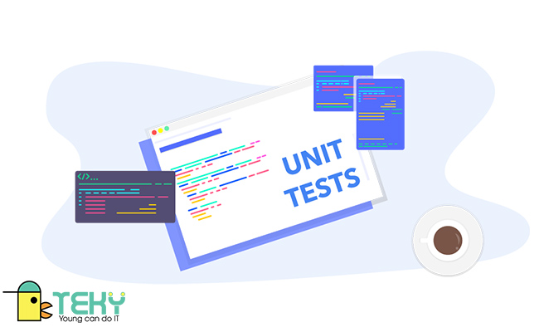
Test case

Slide 8
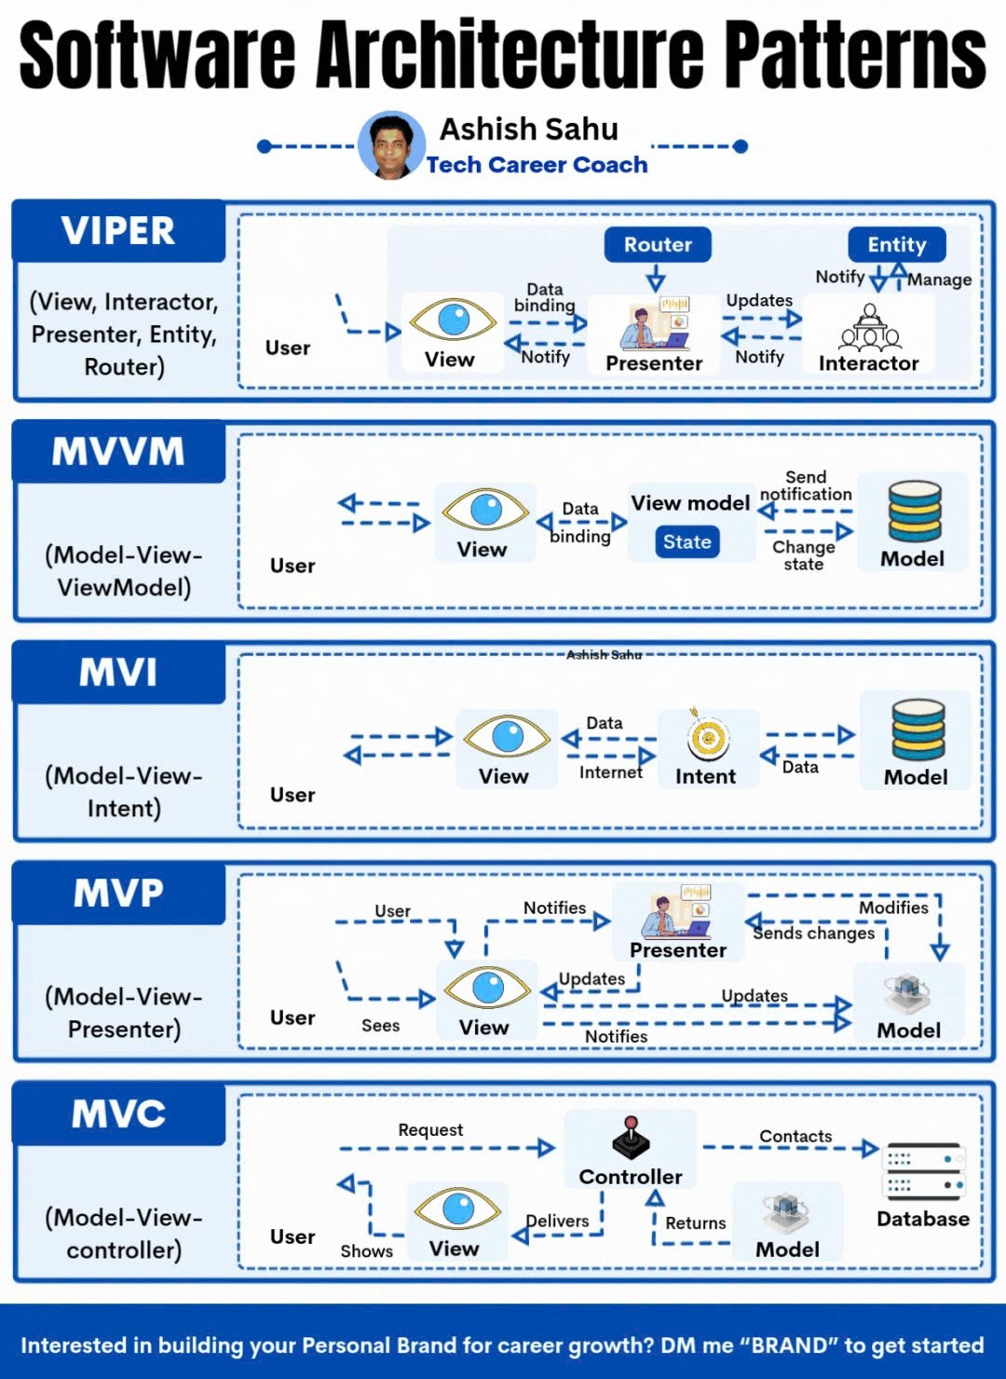
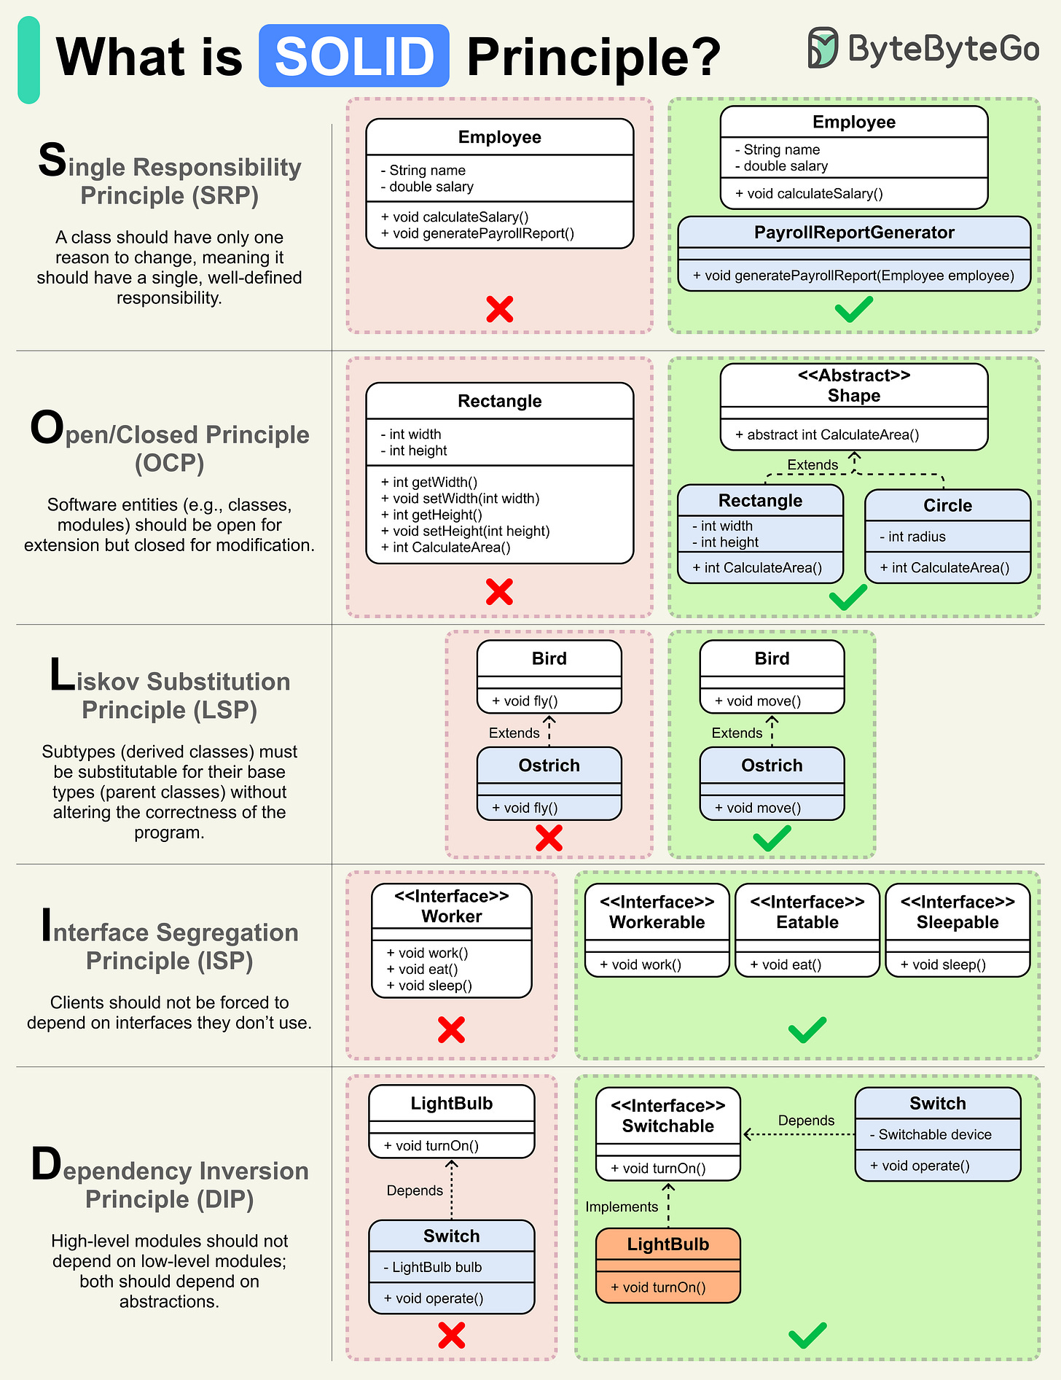
Principles

Slide 9




Tool , Framework

Slide 10

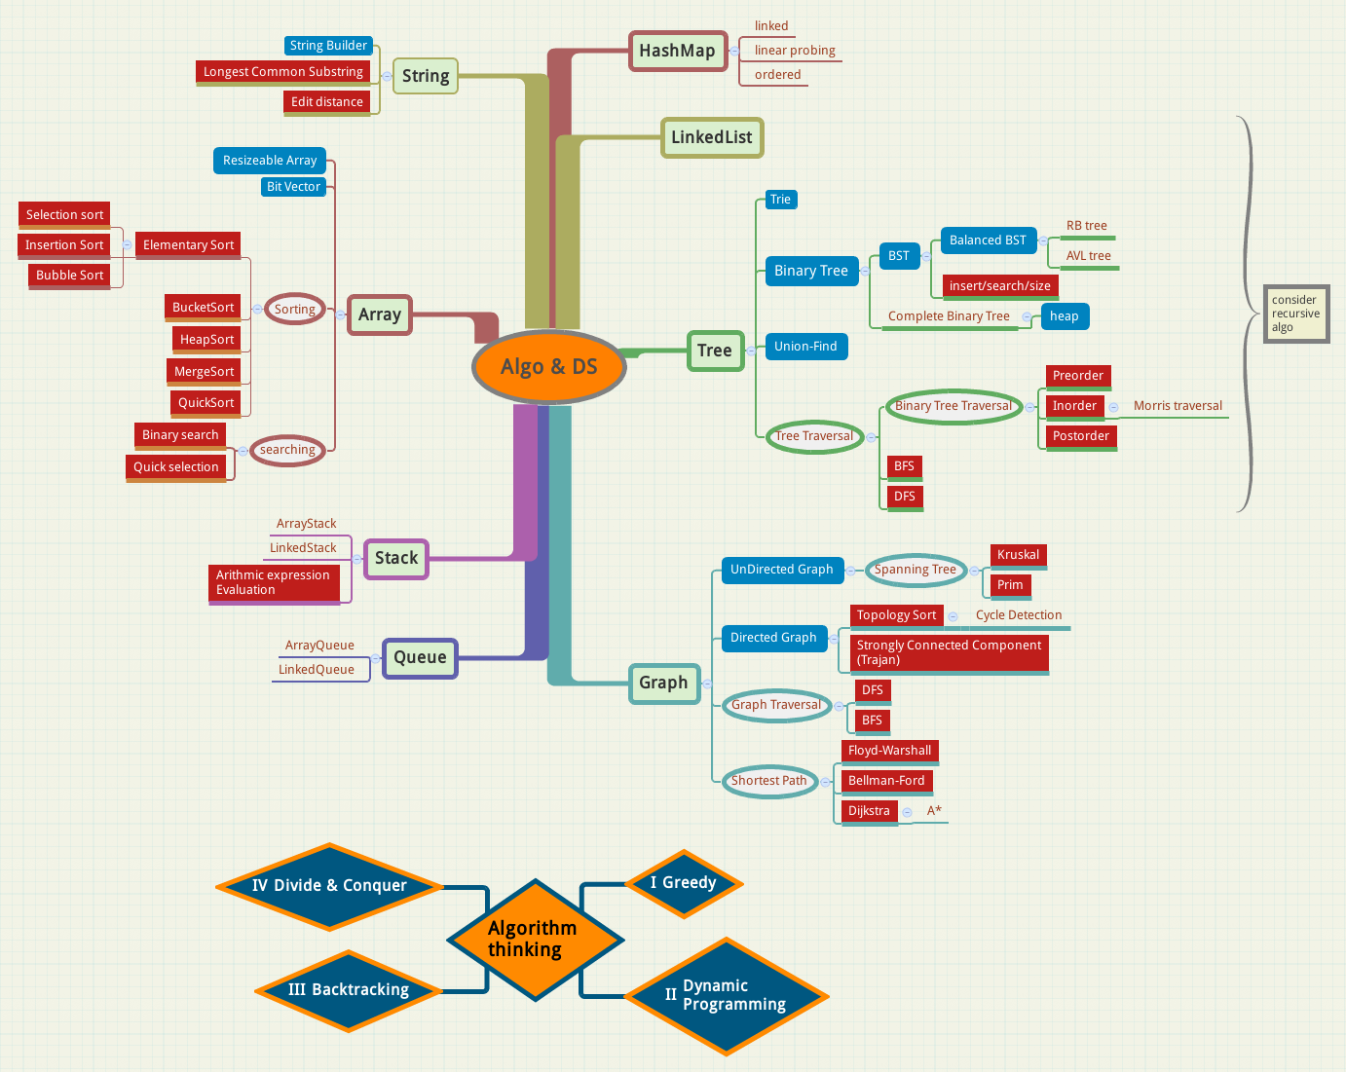
Programming Theory

Slide 11


Career

Slide 12
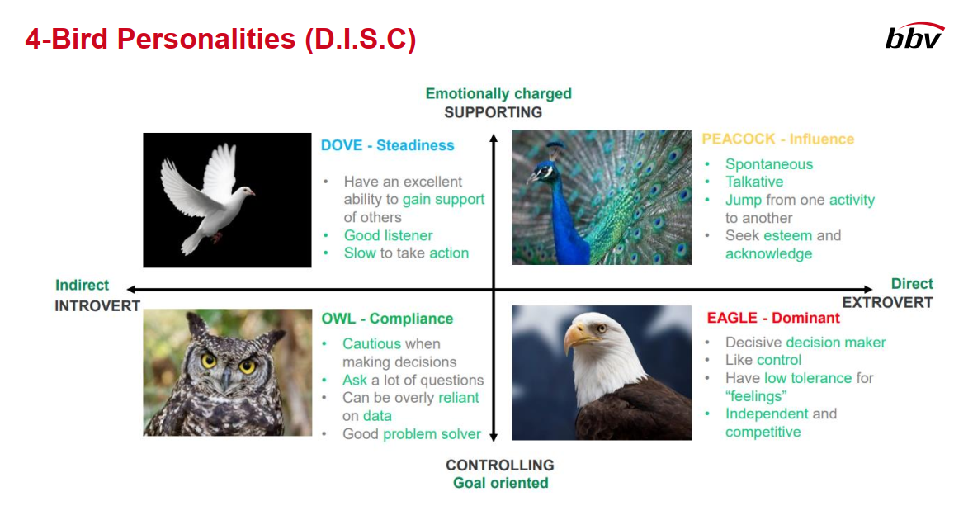
Effective Communication

Slide 13

Critical Thinking

Slide 14
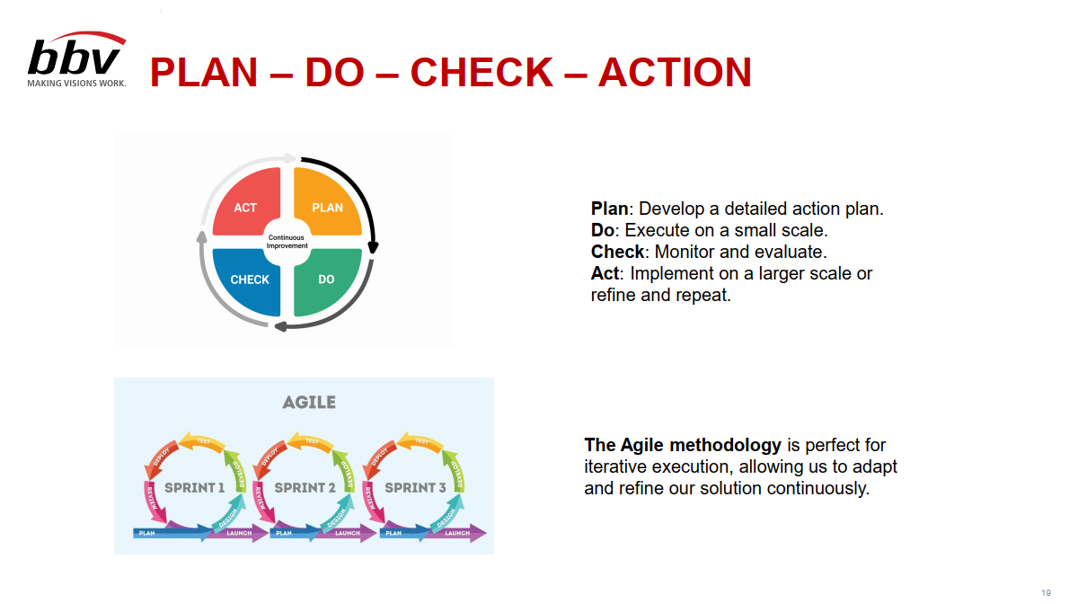
Problem Solving

Slide 15
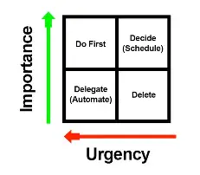

Time management

Slide 16


English Club
This Photo by Unknown Author is licensed under CC BY-NC-ND

Slide 17
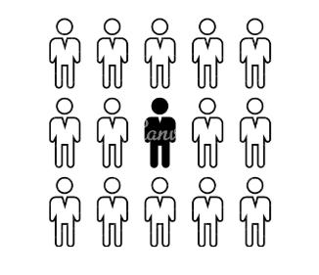
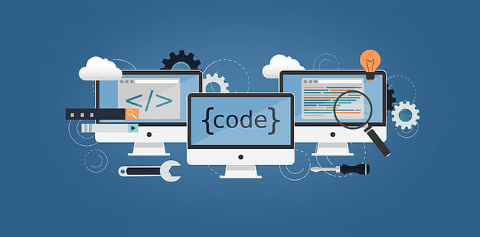
Challenge

Slide 18


Challenge

Slide 19
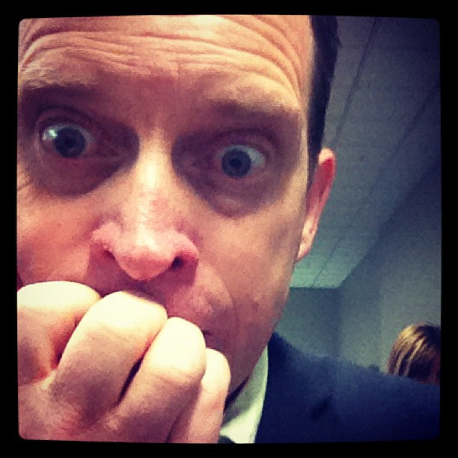

Impact

Slide 20


How to overcome

Slide 21
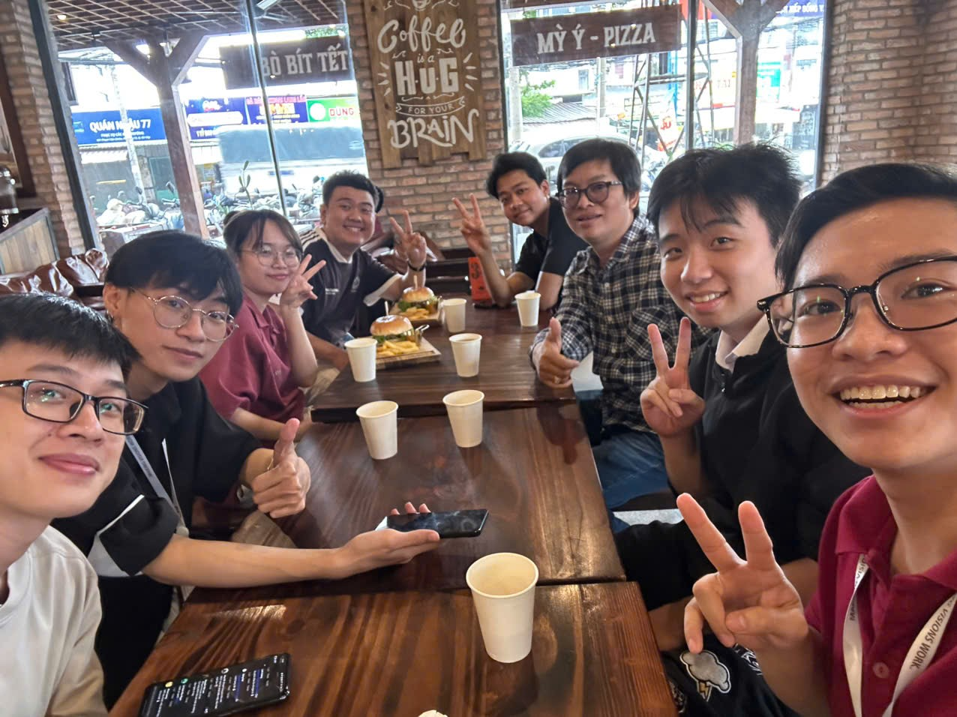
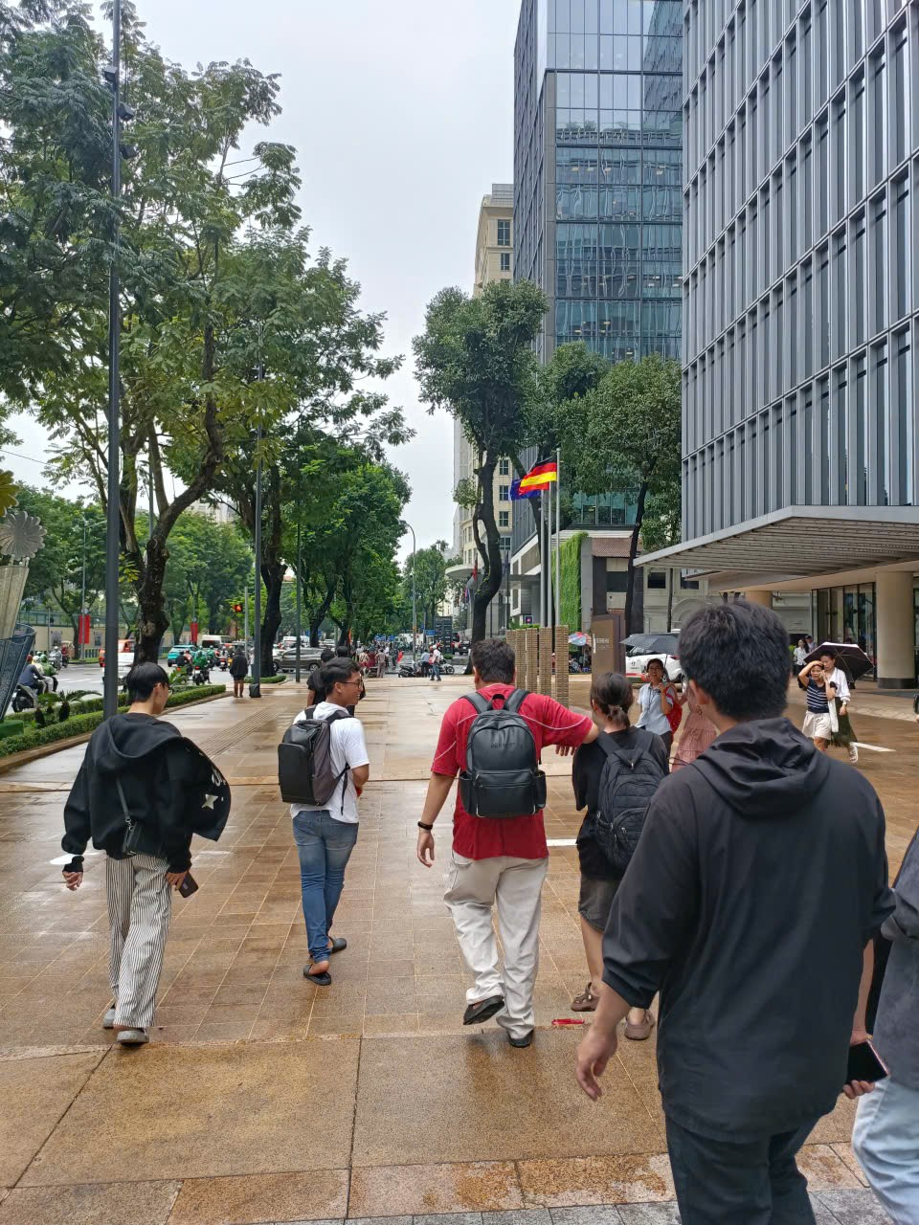
Healing

Slide 22
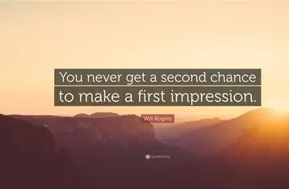
Experience

Slide 23
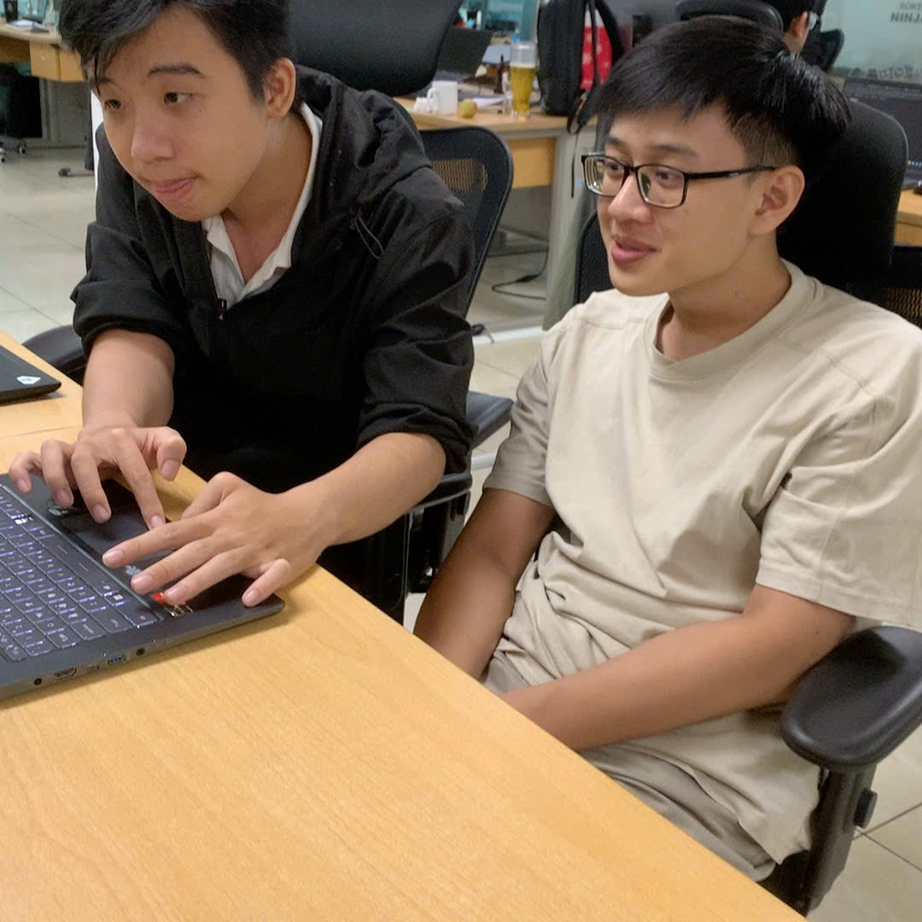
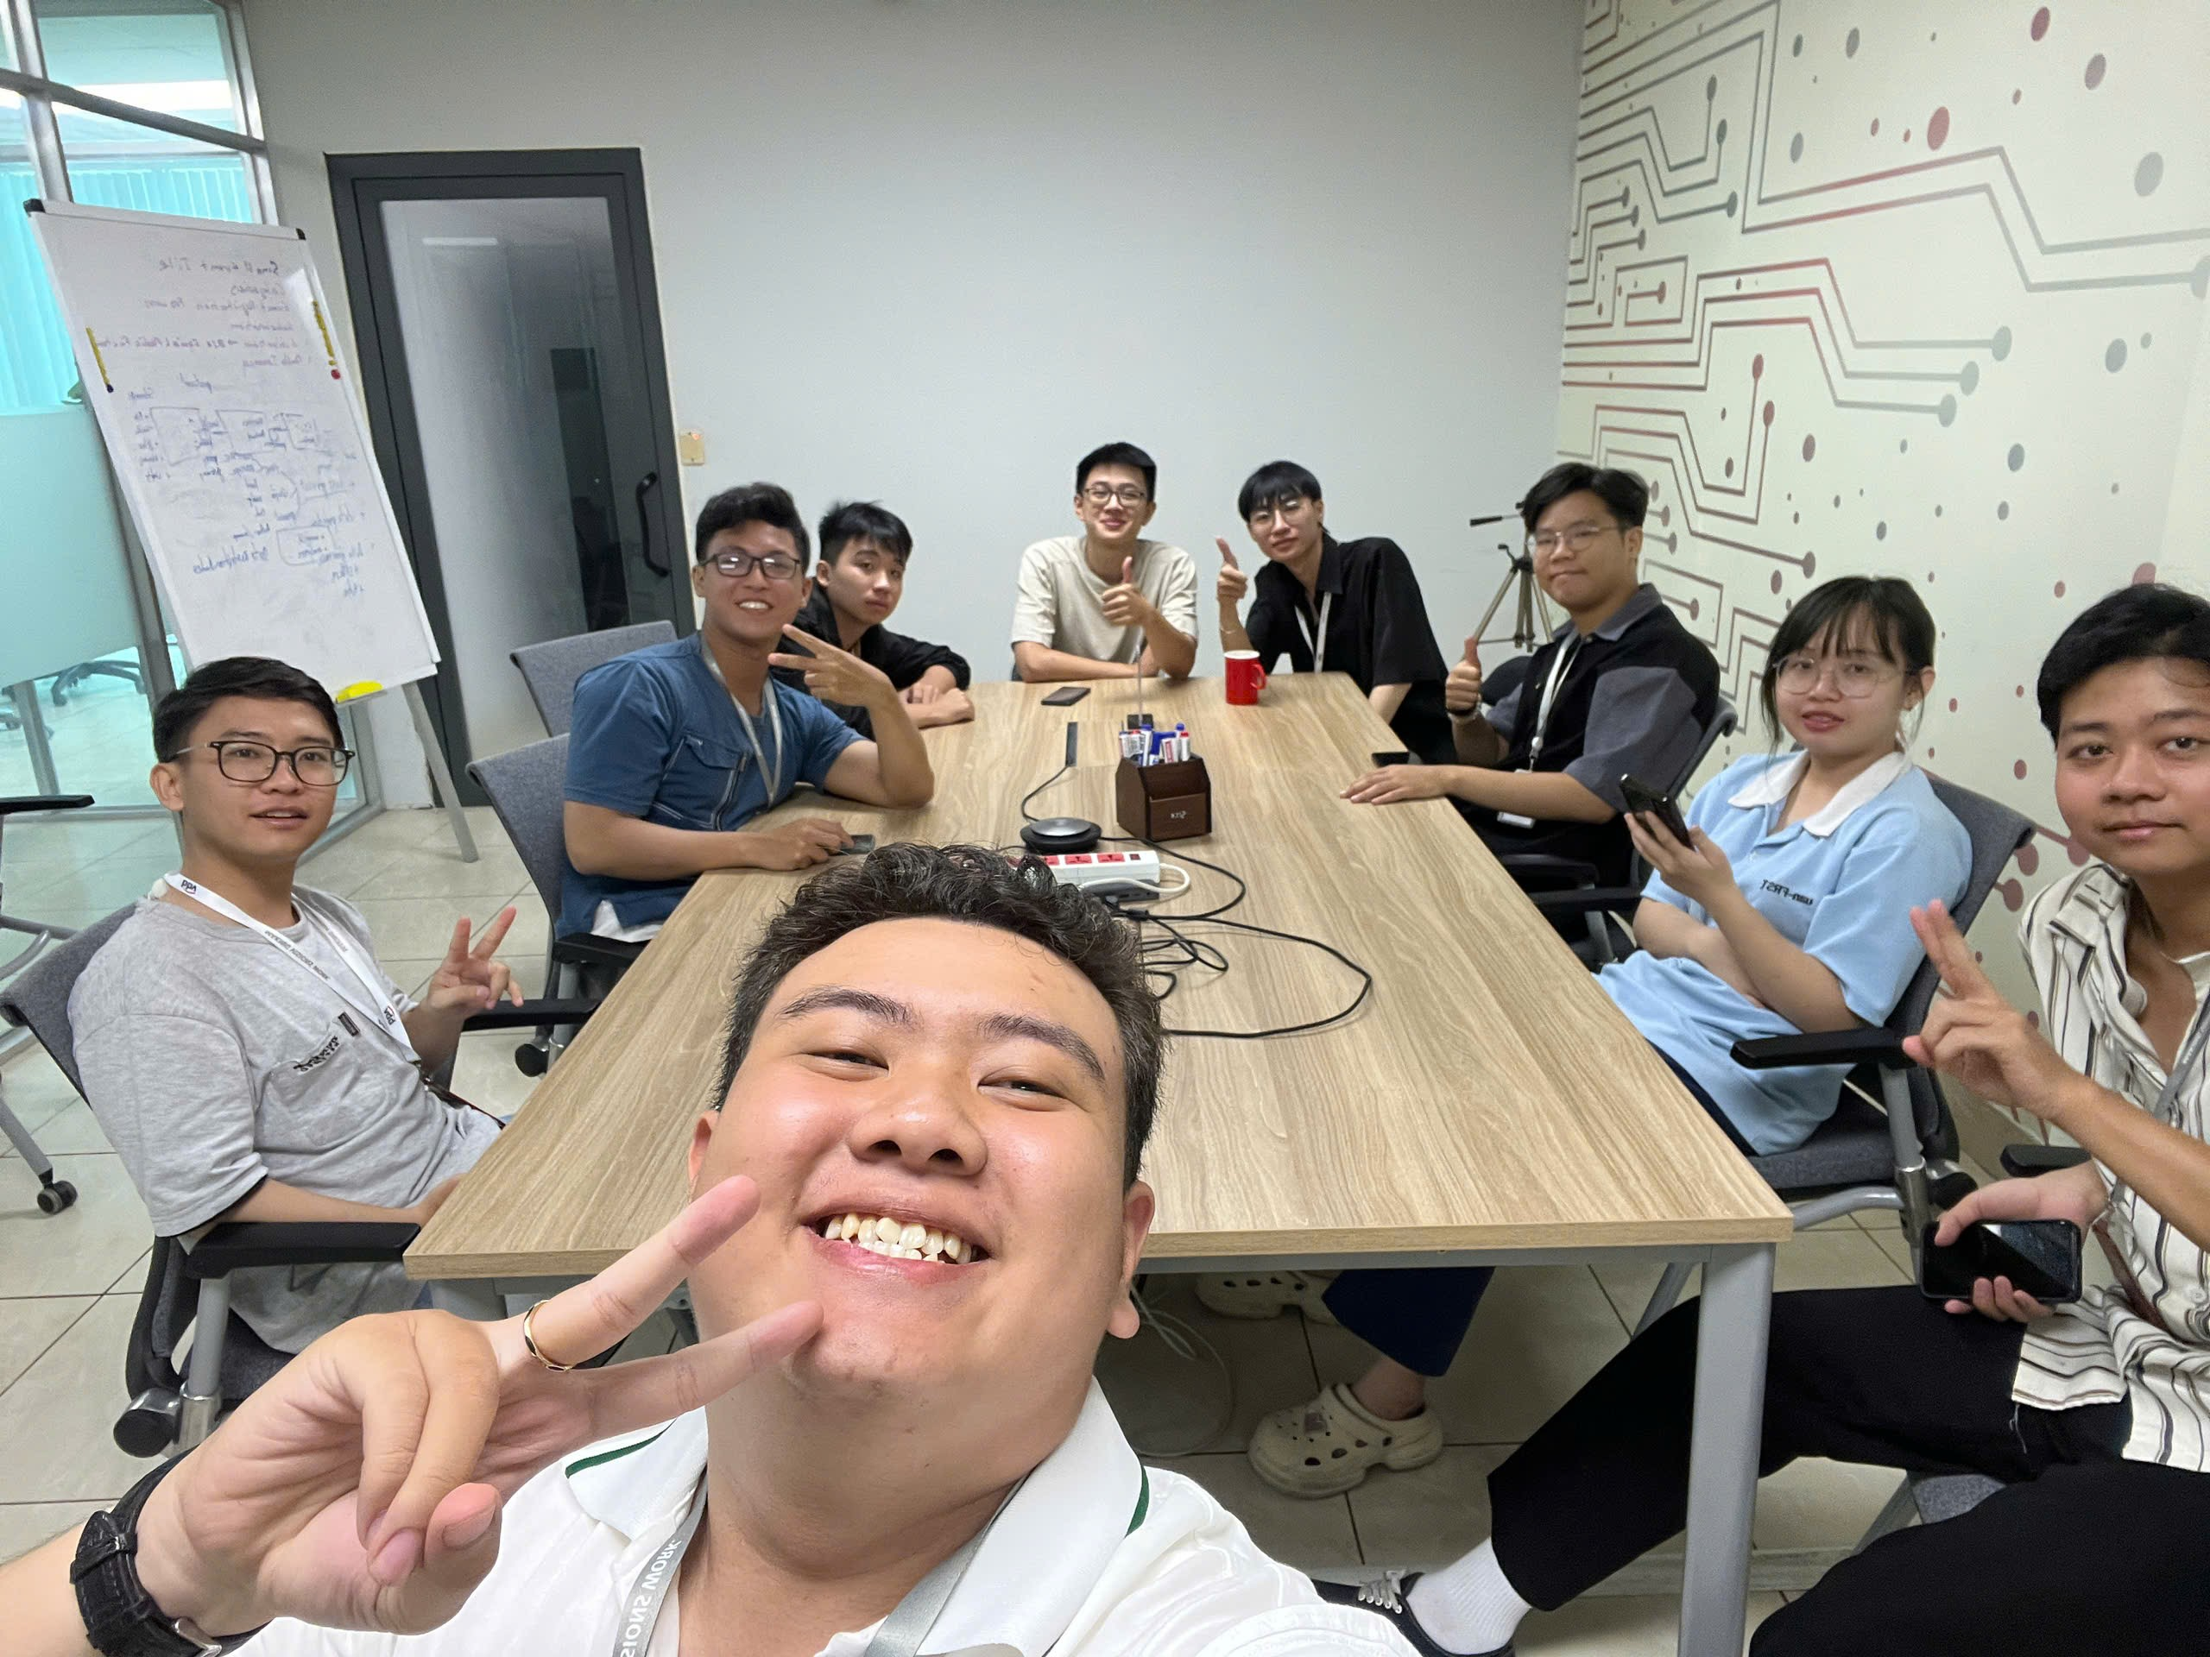
Work & Communicate

Slide 24
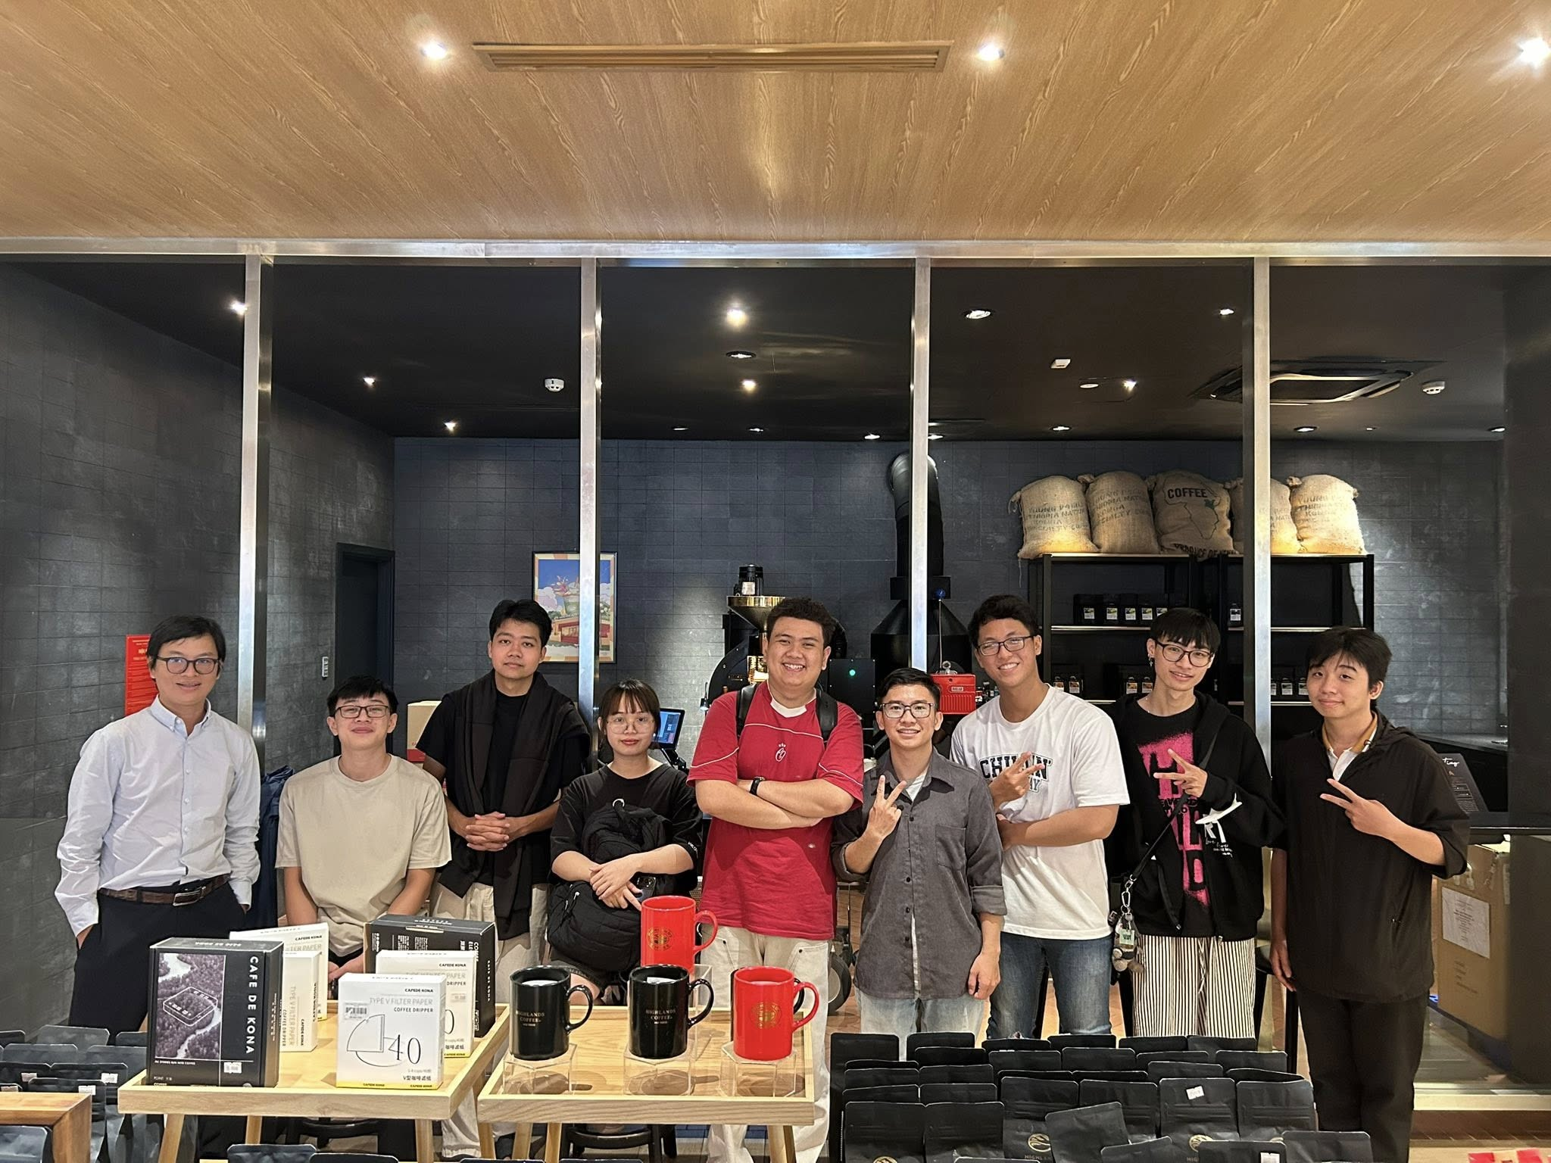
“I’m looking forward to the next milestones to become an even better version of myself.”

Slide 25
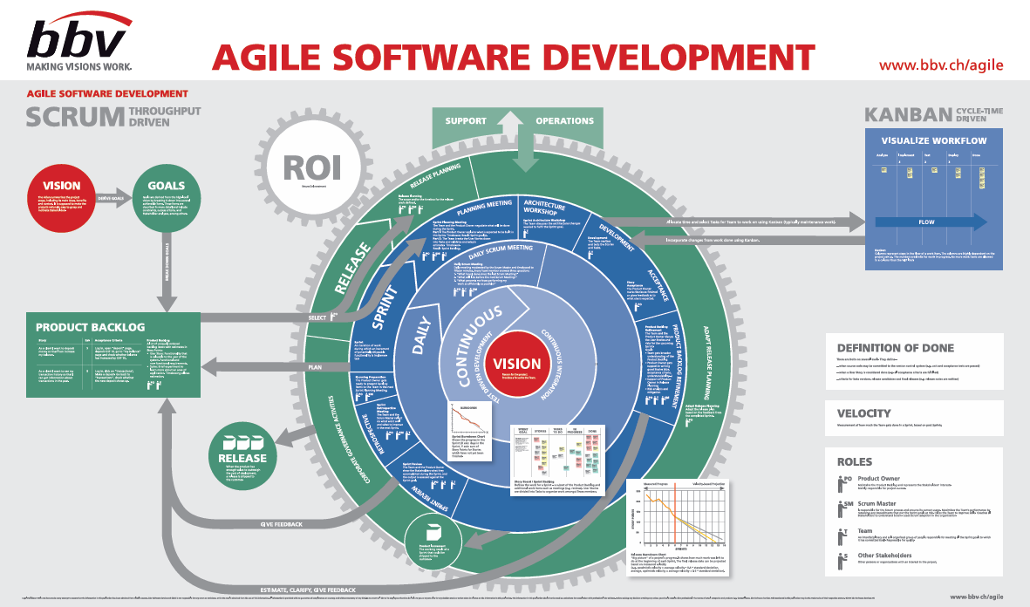
Agile

